Slide 1
RAG Project
Group 25
Srinivas Gundu
Kaveri Pulibandla
Deeksha Pandey
Rahul Pelluri

Slide 2
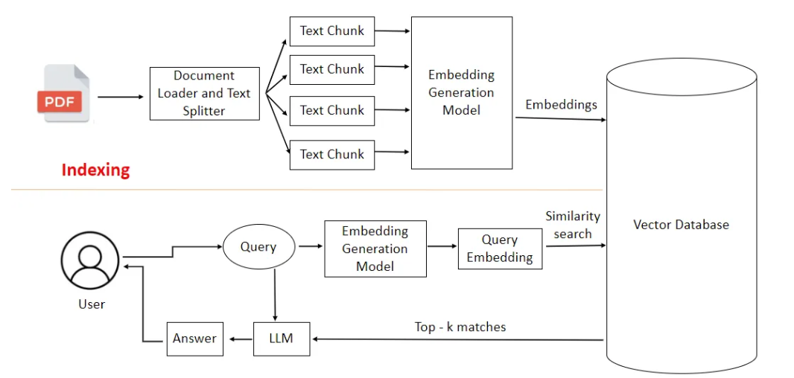
Overview
Utilization
Relevance
Adherence
Completeness
Judge LLM

Slide 3
Scope of Experiments
Data chunking
Embedding Model changes
Using different Vector DBs
Different Retrieval techniques
Modifiying Judge LLM Prompt

Slide 4
Experiments Conducted
Chunking strategies
Experiments
Sentence division
Recursive Character Text Splitter
Semantic Chunking
We stuck to recursive character text splitting. Semantic chunking took too much time and quickly exhausted our GPU credits.
Embedding Model changes
Evaluated Models on MTEB with existing ratings for different db types
Experimented with small and long param models
Vector DBs
Used FAISS and Chroma
Chroma offers more flexibility
Wrt Chroma, added metadata (generated from local LLM) info for better query
The process was GPU intensive and time taking but improved retrieval
Retrieval Techniques
Hybrid, Vector retrieval mechanisms were experimented with

Slide 5
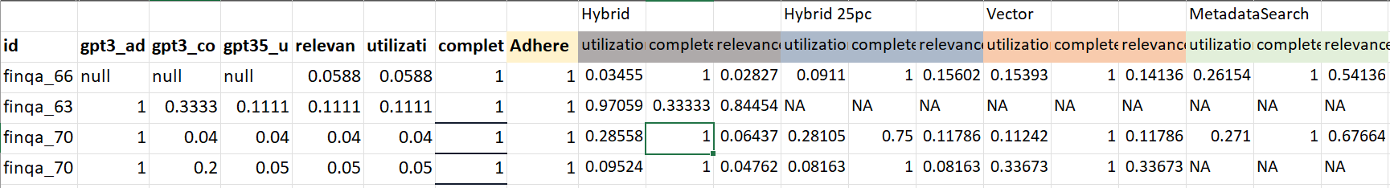
Results
FINQA
Embedding Model: “multilingual-e5_chroma Vector DB: “Chroma” Groq LLM: “llama3-8b-8192“
CovidQA
Embedding Model: “pritamdeka/BioBERT-mnli-snli-scinli-scitail-mednli-stsb” Vector DB: “Chroma” Groq LLM: “llama3-8b-8192“
Hagrid
Embedding Model: “sentence-transformers/all-MiniLM-L6-v2” Vector DB: “FAISS” Groq LLM: “llama3-8b-8192“ Judge Model: deepseek/deepseek-r1:free

Slide 6
Observations
Domain-specific embeddings (BioBERT) significantly improved retrieval relevance.
Sentence-level metadata helped in accurate sentence mapping for judge LLM.
Biomedical LLMs (or high-context generalist models like LLaMA3) performed well with guided prompts.
Some queries had limited support due to lack of precise facts in documents.
Metadata search on Chroma gave better results but the GPU usage became very high and time taking.
Query decomposition took time. But once implemented, it increased the number of retrieved documents and affected the final KPIs.

Slide 7
Best Practices
Save the document data offline
Use MTEB for checking for embedding model. Sort by performance per task.
Save the vector DB
Use multiproc for chunking the data
Chunk size less than 1000 for best results (As per research papers)
Use offline Quantized LLM for running parallel experiments offline
ChromaDB Langchain wrapper does not support some functionality (progress bar, metadata incorporation).
Use Native Chroma library for creating the DB and Langchain for wrapper to query later.
Get summarization words for each chunk from a 7B LLM and feed as metadata. Query on the metadata as well as vector retrieval for best results.

Slide 8
Thank You

